Slide 1
EPA143A: Macroeconomics Week 3: Keynesian Macro-Economics
Key assumptions of the Keynesian macro model:
No in-built tendency towards full employment; unemployment is the norm
Aggregate demand is the main determinant of the level of economic activity (via the multiplier process)
Autonomous investment demand is the key item of aggregate demand; consumption is a stable proportion of income
Autonomous investment demand is determined by ‘expectations’ of firms (animal spirits)
The future is unknowable; there is fundamental uncertainty; self-fulfilling prophecies
Economic activity exhibits business cycles; (counter-cyclical) fiscal stabilisation policy works
The loanable-funds market does not exist; banks are money-creating institutions; investment is pre-financed by credit; there is no crowding out
Monetary policy is less ‘powerful’ than fiscal policy
Money is a social institution which helps agents to deal with uncertainty (by allowing a postponement of spending)

Slide 2
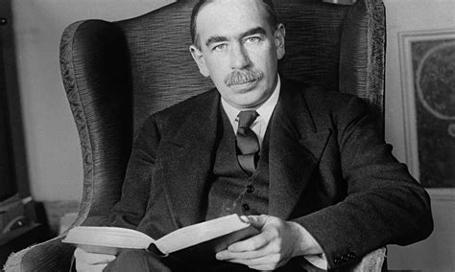
EPA143A: Macroeconomics Week 3: Keynesian Macro-Economics
John Maynard Keynes
(1883-1946) spearheaded
a revolution in economic
thinking, overturning the
neoclassical model.
Keynes argued that aggregate demand
(and autonomous business investment in particular) is the key driver of
economic activity, (un-)employment and the business

Slide 3
EPA143A: Macroeconomics Week 3: Keynesian Macro-Economics
The Keynesian model:
Step 1: an increase in autonomous private investment; pre-financed by new credit from commercial banks; firms have optimistic expectations about future demand and buy extra machines to expand productive capacity; hence, investment demand (= the demand for machines) rises.
Step 2: the multiplier process: output & employment rise in the capital-goods producing industries; income earned in these industries rises; households increase their spending and buy (consumer) goods; production in the consumer-goods producing industries rises; etc.

Slide 4
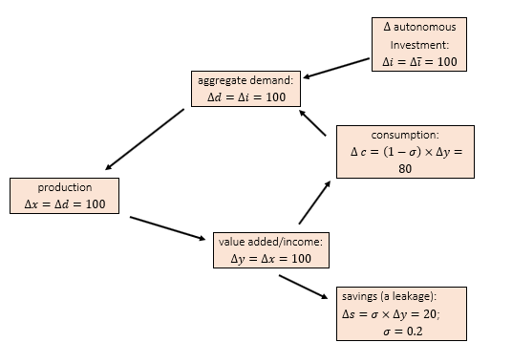
EPA143A: Macroeconomics Week 3: Keynesian Macro-Economics
The Keynesian (demand-determined) circular flow of income:

Slide 5
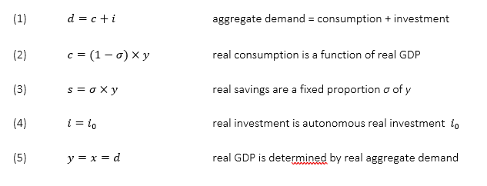
EPA143A: Macroeconomics Week 3: Keynesian Macro-Economics
The Keynesian macro-model:

Slide 6

EPA143A: Macroeconomics Week 3: Keynesian Macro-Economics
The Keynesian multiplier:
or: change in income = the multiplier x change in investments
The multiplier (in this simple model) = 1/sigma
The revolutionary import of Keynes’s macro-economic theory was that there is no self-correcting property or mechanism in the market economy to bring the level of economic activity back to ‘full employment’. Keynes argued that a market economy tends towards an ‘under-employment equilibrium’ – a steady state featuring unemployed workers and unused production capacity.

Slide 7
EPA143A: Macroeconomics Week 3: Keynesian Macro-Economics
Key insights:
There is no market for loanable funds. There is no need for banks to first (ex-ante) mobilize ‘savings’ which can next (ex-post) be used to fund new investment.
business investment is not constrained by the availability of savings, because banks are money-creating institutions which can provide new money (as credit) to finance the investment plans.
a higher propensity to save constitutes a bigger leakage from the circular flow of income; this bigger leakage weakens the multiplier process and will reduce economic growth -> paradox of thrift

Slide 8
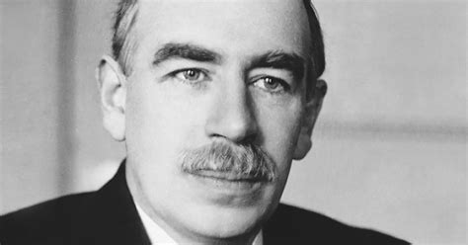
EPA143A: Macroeconomics |Week 3
John Maynard Keynes:
„Economics is a science of thinking in terms of models joined to the art of choosing models which are relevant to the contemporary world.
It is compelled to be this, because, unlike the typical natural science, the material to which it is applied is, in too many respects, not homogeneous through time.”
Letter to Roy Harrod (4 July 1938), in The Collected Writings of John Maynard Keynes, Vol. XIV (1971), p. 297

Slide 9
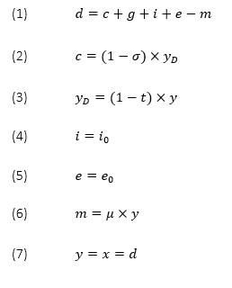

EPA143A: Macroeconomics Week 3: Keynesian Macro-Economics
A more realistic multiplier (derived from a more realistic model):

Slide 10
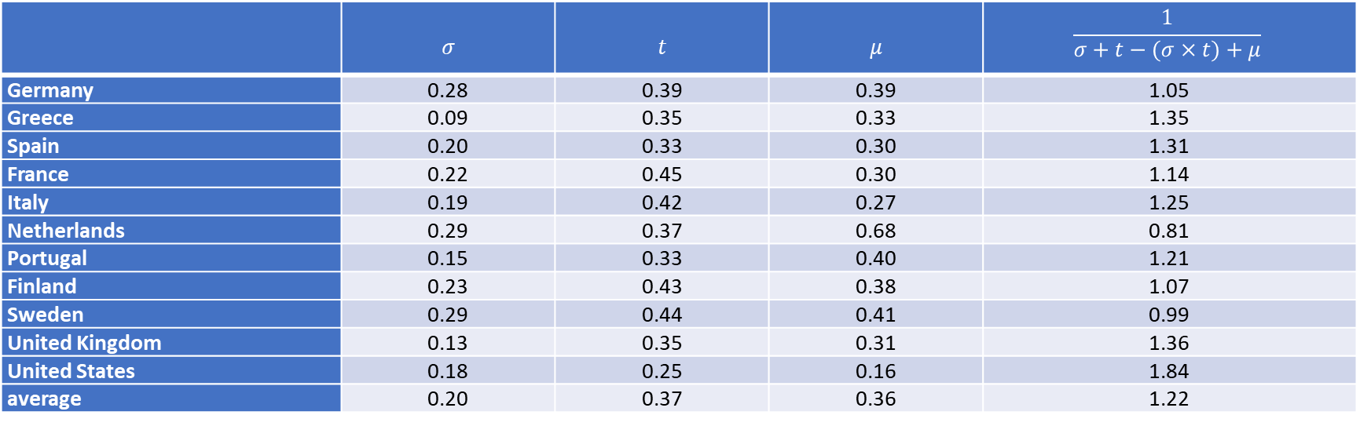
Fiscal multiplier value for selected OECD countries, 2008-2019 Source: AMECO database. Notes: σ= current national savings as a ratio of current GDP; t= total tax burden as a ratio of current GDP; μ= imports at current prices as a ratio of current GDP. All values are annual average for the period 2008-19.
 | $$σ$$ | $$t$$ | $$μ$$ | $$\frac{1}{σ+t−(σ×t)+μ}$$
Germany | 0.28 | 0.39 | 0.39 | 1.05
Greece | 0.09 | 0.35 | 0.33 | 1.35
Spain | 0.20 | 0.33 | 0.30 | 1.31
France | 0.22 | 0.45 | 0.30 | 1.14
Italy | 0.19 | 0.42 | 0.27 | 1.25
Netherlands | 0.29 | 0.37 | 0.68 | 0.81
Portugal | 0.15 | 0.33 | 0.40 | 1.21
Finland | 0.23 | 0.43 | 0.38 | 1.07
Sweden | 0.29 | 0.44 | 0.41 | 0.99
United Kingdom | 0.13 | 0.35 | 0.31 | 1.36
United States | 0.18 | 0.25 | 0.16 | 1.84
average | 0.20 | 0.37 | 0.36 | 1.22

Slide 11

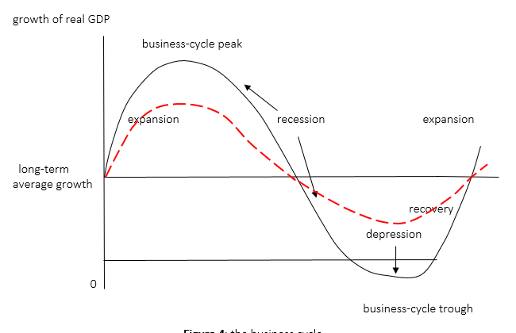
EPA143A: Macroeconomics Week 3: Keynesian Macro-Economics
Fiscal policy in the Keynesian model: the Fiscal Multiplier
Counter-cyclical
fiscal policy;
demand management

Slide 12
EPA143A: Macroeconomics Week 3: Keynesian Macro-Economics
Fiscal stablisation policy (counter-cyclical demand management):
In the down-swing of the business cycle: fiscal deficit
In the up-swing (boom) of the business cycle: fiscal surplus
Over the whole business cycle: a balanced budget
The fiscal multiplier, public debt-to-GDP ratio and fiscal austerity:
suppose govt. investment is reduced -> fiscal surplus -> debt goes down, BUT if fiscal multiplier > 1, then GDP will decline more than public debt -> public debt-to-GDP ratio will go up!

Slide 13
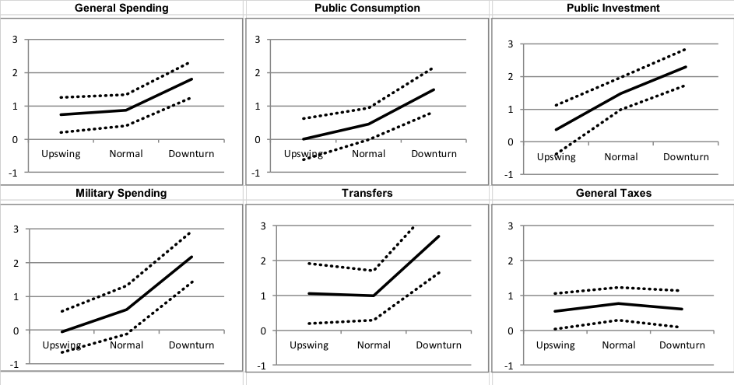
EPA143A: Macroeconomics Week 3: Keynesian Macro-Economics
Fiscal multipliers by type of impulse and depending on the business cycle. Source: Gechert and Rannenberg (2018).

Slide 14
EPA143A: Macroeconomics Week 3: Keynesian Macro-Economics
The IMF changed its position on the magnitude of fiscal multipliers:
Fiscal multipliers have actually been in the 0.9 to 1.7 range since 2008. This means that higher public spending will lead to a DECLINE in the public debt to GDP ratio.
Suppose public spending increases by €100.
Public debt will go up by €100.
GDP will increase by more than €100 if the fiscal multiplier is > 1.
Hence, the ratio public debt to GDP goes down.
The Blanchard-Leigh paper was remarkable, because through this paper, the International Monetary Fund admitted that it had grossly underestimated the impact of the fiscal austerity regime it advised Europeans to adopt. The IMF forecast originally that economic activity would be reduced by only €0.50 for every €1.00 fiscal spending cut. Blanchard and Leigh’s paper shows that the OECD, the EU, the IMF and the Economist Intelligence Unit all got their forecasts wrong, as they were all working with underestimated multiplier values.

Slide 15
EPA143A: Macroeconomics Week 3: Keynesian Macro-Economics
Monetary policy in the Keynesian model:
Policy instrument of central bank = the interest rate
A higher interest rate will lower private investment -> a negative multiplier effect on demand, output, employment
However, the impact of changes in the interest rate on business investment is relatively small, especially that of a reduction in the interest rate
Monetary policy is by far not as effective in influencing demand, output and employment than fiscal policy

Slide 16
EPA143A: Macroeconomics Week 3: Keynesian Macro-Economics
The liquidity trap:
In a period of slow growt and high uncertainty, households and firms will hold on to their cash (= liquidity) for precautionary reasons.
This means that liquidity preference is high. Incomes are not spent, banks are flushed with (excess) savings.
A reduction in the interest rate will not increase business investment, because firms’ animal spirits are depressed (business confidence is low).
Monetary policy (lowering interest rates) cannot get the economy out of the liquidity trap. Interest rates may be lowered to the ZLB without effect.
Fiscal stimulus (rising public deficits) increase aggregate demand and raise economic growth and can restore business confidence.

Slide 17
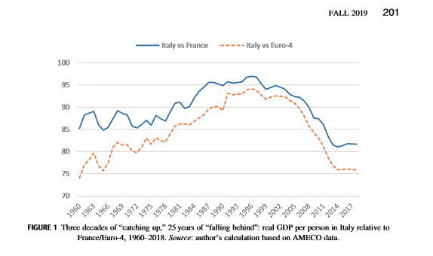
EPA143A: Macroeconomics Week 3: Keynesian Macro-Economics
Lost in Deflation: Italy’s structural economic crisis

Slide 18

EPA143A: Macroeconomics Week 3: Keynesian Macro-Economics
Keynesian explanation of the structural crisis in Italy:
The structural causes of the structural demand deficiency are: (1) very low growth of real wages; declining real household incomes; (2) declining real public expenditure; fiscal austerity (the permanent primary fiscal surplus); and (3) poor export performance, partly due to the fact that the euro exchange rate is too high from the viewpoint of the Italian economy.
Insufficient aggregate demand (AD) → decline in PROFIT RATE → stagnating business investment → further decline in AD → etc.
PROFIT RATE & demand:
where u = capacity utilisation which is determined by AD.
Lower AD → lower u → lower profit rate → lower business investment

Slide 19

EPA143A: Macroeconomics Week 3: Keynesian Macro-Economics
Fiscal austerity can be self-defeating, i.e. lowering the government deficit can lead to an increase in the public debt to GDP ratio (when the fiscal multiplier > 1).
Debt-dynamics equation:
Δ debt = the change in the ratio of nominal public debt to nominal GDP
Fiscal deficit = government revenue – government expenditure
i = the nominal interest rate paid on government debt (the government borrows to pay the interest on the outstanding public debt)
g = the growth rate of nominal GDP

Slide 20
EPA143A: Macroeconomics Week 3: Keynesian Macro-Economics
Suppose:
the fiscal deficit = 3% of GDP = net borrowing by the state
the nominal interest rate = 2.5% and nominal GDP growth (g) = 3.5%
Debt = 1 = the ratio of nominal public debt to nominal GDP
As result, Δ debt = +3% + (2.5% - 3.5%) x 1 = +2%
Now suppose the fiscal deficit is lowered to 0%; the fiscal multiplier = 1.5
the fiscal deficit = 0% of GDP = net borrowing by the state
the nominal interest rate = 2.5% and nominal GDP growth (g) = -4.5%
Debt = 1 = the ratio of nominal public debt to nominal GDP
As result, Δ debt = +0% + (2.5% - - 4.5%) x 1 = +7%

